Slide 1
Professional Portfolio
STUDENT NAME: AFROSENISHA.S
REGISTER NO AND NMID:asunm1729222411241
DEPARTMENT: BACHLOR OF COMPUTER SCIENCE
COLLEGE: PRINCE SHRI BALAJI ARTS AND SCIENCE COLLEGE
UNIVERSITY: UNIVERSITY OF MADRAS

Slide 2
PROJECT TITLE
Professional Portfolio

Slide 3


AGENDA
Problem Statement
Project Overview
End Users
Tools and Technologies
Portfolio design and Layout
Features and Functionality
Results and Screenshots
Conclusion
Github Link
3/21/2024 Annual Review

Slide 4

PROBLEM STATEMENT
1.Main Issues:
Need for Quick Platforms: Recruiters and clients prefer efficient, interactive platforms to evaluate candidates.
2.Lack of Online Identity:
Many talented individuals do not have a personal online presence, leading to missed opportunities.
3.Potential Solutions:
Consider developing a platform that: Showcases Talents: Allows users to create profiles highlighting their skills, experiences, and projects. Enhances Connectivity: Offers interactive features for recruiters to engage with candidates easily.
4.Promotes Visibility: Implements SEO strategies to make profiles discoverable by potential employers.

Slide 5

PROJECT OVERVIEW
1.Objective:
Develop a modern, responsive, and user-friendly portfolio website. Serve as a personal brand hub, showcasing skills, projects, and achievements.
2.Technologies Used:
Built with HTML, CSS, and JavaScript to ensure a clean UI and smooth UX.
3.Goal:
To make a lasting impression on recruiters and clients.

Slide 6

WHO ARE THE END USERS?
👩‍🎓 Students- Showcase projects & skills.
👔 Job Seekers - Impress recruiters.
👨‍💻 Freelancers- Attract global clients.
🏢 Organizations- Quick evaluation of candidates.
💡 Portfolio= Digital Resume + Creative Showcase.

Slide 7

TOOLS AND TECHNIQUES
1.Frontend Technologies:HTML5, CSS3,JavaScript:
Eessential languages for building the structure, styling, and interactivity of the website.
2.Design Tools:
Flexbox and CSS Grid: Valuable for creating responsive layouts and ensuring the website looks great on all devices. 3.Emphasis on Responsive UI Principles:
To enhance user experience across various screen sizes.
4.Editor vs Code:
A powerful, widely-used code editor that supports various extensions to streamline development.
5.Version Controll:Git & GitHub:
Critical for tracking changes in code, collaborating with others, and maintaining a history of project development.

Slide 8
POTFOLIO DESIGN AND LAYOUT
1.Header & Navigation: Provides easy access to the main sections.
2.Hero Banner: Features a welcoming message, “Hello, I’m [Roshini.R]”.
3.About Me: A brief introduction to your background and experience.
4.Skills Showcase: Displays key skills and proficiencies. 5.Projects Gallery: Highlights work samples with descriptions. 6.Contact Form: Allows visitors to reach out directly.
7.Footer: Contains supplementary links and information.
8

Slide 9
FEATURES AND FUNCTIONALITY
1.Responsive Design: - Ensures usability across all devices, from smartphones to desktops.
2.Smooth Navigation & Scrolling: - Enhances user experience by providing quick, seamless transitions between sections. 3.Highlighted Skills: - Displayed in creative tags, making it easy for recruiters to identify relevant proficiencies.
4.Interactive Project Cards: - Engage users through visual and interactive elements, showcasing various projects effectively. 5.Live Alert Contact Form: - Provides immediate feedback on submissions, improving communication with visitors. 6.Professional Branding: - Simple design elements that maintain a polished, professional appearance.

Slide 10
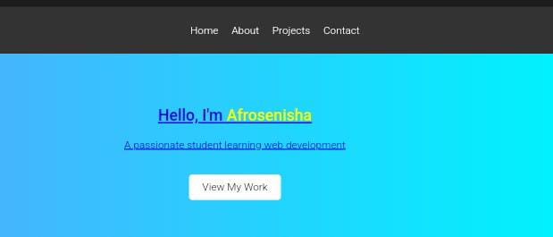

RESULTS AND SCREENSHOTS
3/21/2024 Annual Review
10

Slide 11
CONCLUSION
🧠 Through this project, I gained valuable knowledge in:
°Front-end Web Development (HTML, CSS, JavaScript).
° Building Responsive and Interactive Layouts.
11

